Slide 1
Unit – 2
Data Models

Slide 2
Content
2.1. Introduction to Entity Relationship Model 2.2. Entities type
2.3. Entities set
2.4. Attributes and keys
2.5. Relationship types and sets
2.6. E-R diagrams

Slide 3
Data Models
Data model is a collection of conceptual tools used for describing data, data relationships and data constraints.
Data models in a Database Management System (DBMS) are like blueprints (structure or design)for how information is stored, organized, and accessed within a database.
They provide a structured way to represent and interact with data

Slide 4
Some terms in data models
Data constraints in data models in a DBMS are rules and conditions that define the acceptable values and relationships for data attributes, ensuring data integrity and consistency.
Data integrity in a DBMS refers to the accuracy and reliability of data, while data consistency ensures that data remains in a valid OR right state throughout its lifecycle.

Slide 5
Data model
It is like architectural plan of a building

Slide 6
What is blueprint in DBMS?
In the context of a Database Management System (DBMS), a "blueprint" refers to the a detailed plan structure and design of the database, including the arrangement of tables, relationships between data, and the data model used, to ensure efficient storage and retrieval of information.

Slide 7
Data Models in DBMS
These data models help define how data is structured, how it can be related, and how it's retrieved.
The choice of data model depends on the type of data you're dealing with and the requirements of your application.
It's like choosing the right tool to organize and access information effectively.

Slide 8
Data Model
Data models in a Database Management System (DBMS) are essential because they provide a structured framework for organizing and representing data, enabling efficient data storage, retrieval, and management, and ensuring data consistency and integrity.

Slide 9
Terms
A structured framework refers to a well-defined and organized system for storing and managing data with clear rules and relationships.

Slide 10
Types of data model
1. Conceptual data model
Logical data model
Physical data model

Slide 11
Conceptual Vs logical vs physical data model
In a DBMS, a conceptual model focuses on abstract data(hide details) concepts, a logical model defines the structure and relationships of the data without considering implementation, and a physical model details how the data is stored and accessed in a specific database system.

Slide 12
Types of data model
1. Conceptual data model:=>
A conceptual data model identifies the highest-level relationships between the different entities.
A conceptual model represents the most abstract and generalized relationships among data elements in a way that does not involve specific database design or implementation details.

Slide 13
Types of data model
1. Conceptual data model:=>
Features of conceptual data model include:
a. Includes the important entities and the relationships among them.
b. Abstract (hide details)relationships
c. No attribute is specified.
No primary key is specified.
No software tool is required to define a Conceptual data model

Slide 14
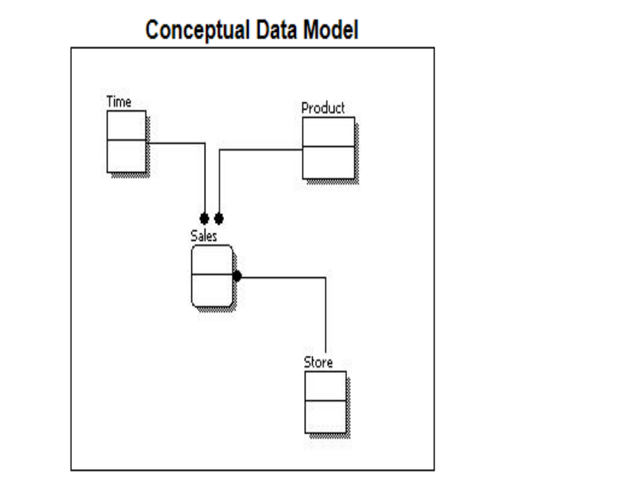
Types of data model

Slide 15
Types of data model
Conceptual Model:=>
-> From the figure above, we can see that the only information shown via the conceptual model is the data and relationships between those entities. -> No other information is shown through the conceptual model

Slide 16
Is conceptual model is only about the concept about the data?
Yes, a conceptual model in the context of data modeling is primarily focused on representing the high-level concepts and relationships of the data without delving (investigate) into the specifics of how data is physically stored or implemented in a database system

Slide 17
Once the conceptual model is finalized , we can look up to the logical data model

Slide 18
Types of data model
2. Logical data model:=>
A logical data model describes the data in as much detail as possible, without regard to how they will be physical implemented in the database

Slide 19
Types of data model
2. Logical data model:=>
Features of a logical data model include:
– Includes all entities and relationships among them.
– All attributes for each entity are specified.
– Key attributes
Non-key attributes
Primary key—Foreign key relationships

Slide 20
Logical data model
Features of a logical data model include:
User friendly attribute names
More detailed than conceptual model
But more effort required to enhance, in comparison to Conceptual model
Database agnostic i.e it can be implemented in any database system.

Slide 21
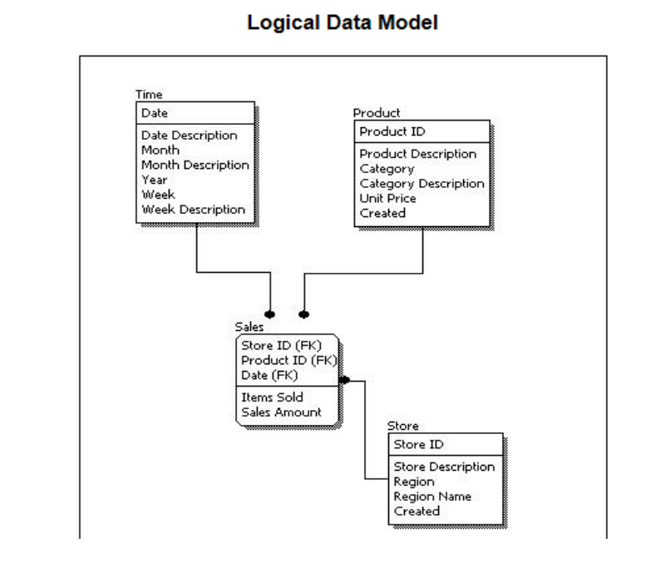

Slide 22
Types of data model
3. Physical data model:=>
Physical data model represents how the model will be built in the database.
A physical database model shows all table structures, including column name, column data type, column constraints (i.e rules and conditions like primary key identifies each record in a table and foreign key establishes a link between two tables), primary key, foreign key, and relationships between tables

Slide 23
Types of data model
Features of physical data model:=>
--- Looks similar to logical data model
--- Entities referred to as tables
---- Attributes referred to as Columns
-- Database compatible table names
.

Slide 24
Features of physical data model:=>
Data base compatible column names
Database specific data types.
Difficult for users to understand
Physical data model will be different for different RDBMS i.e it is specific to database.
For example, data type for a column may be different between MySQL and SQL Server

Slide 25
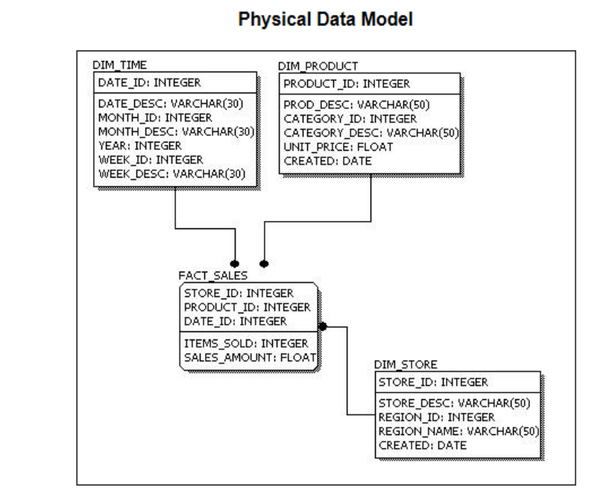

Slide 26
Why do we need data model…?
Structured representations of data at different levels in databases (conceptual, logical, and physical) are needed to provide a systematic and organized framework for understanding, designing, and implementing complex data systems, ensuring clarity, consistency, and efficiency throughout the entire data lifecycle, from conceptualization to storage and retrieval.

Slide 27
Other types of data model :=>
Object based data model :=>
An object-based data model represents data using a structure similar to real-world objects.
An object-based data model organizes data like objects with properties
The Entity relationship model which is an object based model is widely used in practices as an appropriate database design tool

Slide 28
Other types of data model :=>
ii. Record based data model:=>
a record-based data model stores data in structured rows of fixed format.
a record-based data model organizes data into fixed-format rows or records without the concept of objects. * The three widely accepted record based data models are :
– relational model
– network model and
– hierarchical model

Slide 29
Record based vs object based data model
A record-based data model organizes data into simple, tabular structures, while an object-based data model handles complex data structures, often adhering to object-oriented principles.

Slide 30
Question to do
1. Define data model. What are different types of data models? Explain each of them in brief.[10]

Slide 31
Introduction to Entity Relationship Model
An Entity-Relationship Data Model (ER Model) in a Database Management System (DBMS) is a conceptual or logical way to visually represent and describe the relationships between various entities or objects in a database.
It's like drawing a map of how different things are connected and what kind of information each thing holds.

Slide 32
Here's a more detailed explanation:
Here's a more detailed explanation:
Entities: =>
In an ER Model, an entity is like a noun in your database.
It represents an object, concept, or thing that you want to store information about.
For example, in a database for a library, "Book" and "Author" could be entities.
Each entity is typically associated with specific attributes, which are like the characteristics or properties of that entity.
For a "Book" entity, attributes might include "Title," "Author," and "Publication Date.

Slide 33
Here's a more detailed explanation:
2. Attributes:=>
Entities are represented by means of their properties, called attributes.
All attributes have values.
For example, a student entity may have name, class, and age as attributes.
There exists a domain or range of values that can be assigned to attributes.
For example, a student's name cannot be a numeric value. It has to be alphabetic. A student's age cannot be negative, etc.

Slide 34
Here's a more detailed explanation:
3. Relationships or Association: =>
Relationships in an ER Model define how entities are connected or related to each other.
These relationships can be one-to-one, one-to-many, or many-to-many.
For instance, in the library database, there's a "Wrote" relationship between the "Author" and "Book" entities, indicating that an author can write many books (one-to-many).

Slide 35
Attributes
Entities are represented by means of their properties, called attributes.
All attributes have values.
For example, a student entity may have name, class, and age as attributes.
There exists a domain or range of values that can be assigned to attributes.
For example, a student's name cannot be a numeric value. It has to be alphabetic. A student's age cannot be negative, etc.

Slide 36
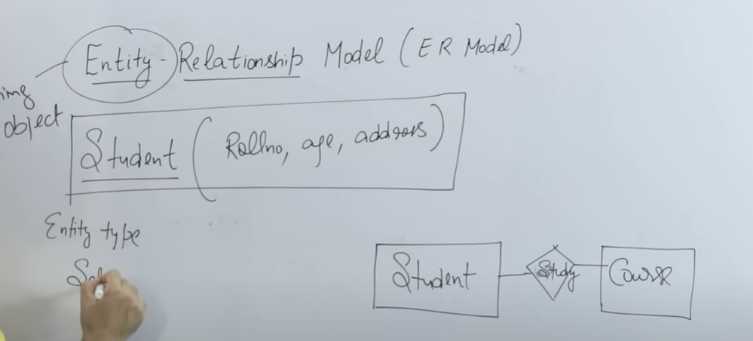
Here's a more detailed explanation:

Slide 37
E-R model: Summary
Further, we implement E-R model by using SQL.
In summary,
Entity=> Those which have physical existence.(Rectangle)
Attribute :=> Features or characteristics of entity (eclipse)
Relationship or Association:=> Represent the relation between entity and attribute(Diamonds)

Slide 38
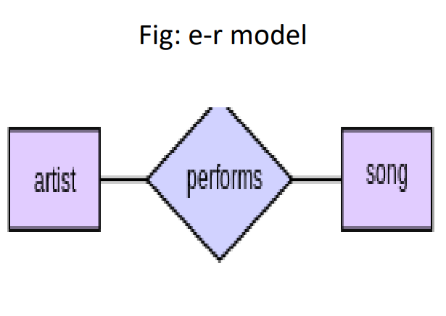

Slide 39
2.2 Entity type
In the Entity-Relationship (ER) model in database management systems (DBMS), an "entity type" represents a category or class of objects, things, or concepts that you want to store and manage data about.
It serves as a blueprint for defining what these entities have in common, such as their attributes and the relationships they may have with other entity types.

Slide 40
2.2 Entity type
Here are some key points to understand about entity types in the E-R model:=>
1. Blueprint for Real-World Objects: An entity type is a conceptual representation of real-world objects, such as "Customer," "Employee," "Product," or "Car."
2. Attributes: Each entity type is associated with a set of attributes that describe the characteristics, properties, or information associated with instances of that entity type. For example, a "Customer" entity type might have attributes like "Name," "Address," and "Phone Number."

Slide 41
2.2 Entity type
5. Relationships: Entity types can be related to each other through relationships. For example, a "Customer" entity type can be related to an "Order" entity type to represent the fact that customers place orders.
6. Abstraction: Entity types represent a level of abstraction that helps in structuring and organizing data in a database. They abstract the common properties shared by similar entities.

Slide 42
2.2 Entity type
3. Instances: Specific objects or instances belonging to an entity type are referred to as entities. For instance, "John Smith" and "Sarah Brown" are individual entities within the "Customer" entity type.
4. Uniqueness: Each entity within an entity type should have a unique identifier, often referred to as a primary key, which ensures that no two entities within that entity type can have the same identifier.

Slide 43
2.2 Entity type: Summary
In summary, an entity type in the E-R model is a way to organize and define categories of objects or concepts within a database, specifying their attributes, relationships, and unique identifiers.
It provides a foundation for designing a database that accurately models and stores information about various types of entities within a given domain.

Slide 44
2.3 Entity set
An entity set is a grouping of entities that share the same attributes.
In other words, an entity set is a group of distinct entities that have the same properties.
An entity set in the ER model serves as a container for organizing and representing groups of similar entities with shared attributes and relationships.

Slide 45
2.3 Entity set
Certainly, let's consider an example of an entity set in the Entity-Relationship (ER) model within a database management system (DBMS). We'll use the "University" scenario:
Entity Set: "Student"
Description: The "Student" entity set represents a category of entities, which are individual students within a university. Here's how it is defined:

Slide 46
2.3 Entity set: Example
Instances (Entities): Each individual student, such as John Smith, Sarah Brown, and David Lee, is an entity within the "Student" entity set.
Attributes: The "Student" entity set would have various attributes that describe each student, such as:
Student ID (a unique identifier for each student)
Name (First name and last name)
Date of Birth
Address
Major or Program of Study
Year of Enrollment

Slide 47
2.3 Entity set
3. Uniqueness: Each student in the "Student" entity set has a unique student ID, ensuring that no two students have the same ID.
3. Relationships: The "Student" entity set can be related to other entity sets in the ER model to represent various relationships, such as:
"Enrollment": To depict the relationship between students and the courses they are enrolled in.
"Advisor": To show the relationship between students and their academic advisors.
"Residence": To indicate where students live on campus.

Slide 48
2.3 Entity set
4. Data Storage: In a relational database, the "Student" entity set's data would be stored in a table, with each row representing a specific student, and columns representing the attributes like "Student ID," "Name," and so on

Slide 49
2.3 Entity set: Summary
This example demonstrates how the "Student" entity set in the ER model encapsulates the information and attributes associated with individual students within a university, making it a foundational element in the design of a database for a university management system.

Slide 50
2.4 Attributes and keys:=>
Entities are represented by means of their properties, called attributes. All attributes have values.
For example, a student entity may have name, class, and age as attributes. There exists a domain or range of values that can be assigned to attributes. For example, a student's name cannot be a numeric value. It has to be alphabetic. A student's age cannot be negative, etc.

Slide 51
2.4 Attributes and keys:=>
Definition: =>
-- Attributes are properties or characteristics that describe entities within an entity set.
--- They provide information about the entities.

Slide 52
2.4 Attributes and keys:=>
Types of Attributes:=>
Simple Attributes: These are atomic attributes that cannot be divided further. For example, "Name" or "Age.“

Slide 53
Types of Attributes:=>
2. Composite Attributes: Composite attributes are made up of multiple simple attributes, grouped together to form a larger attribute. For instance, an "Address" attribute may have sub-attributes like "Street," "City," and "Postal Code."

Slide 54
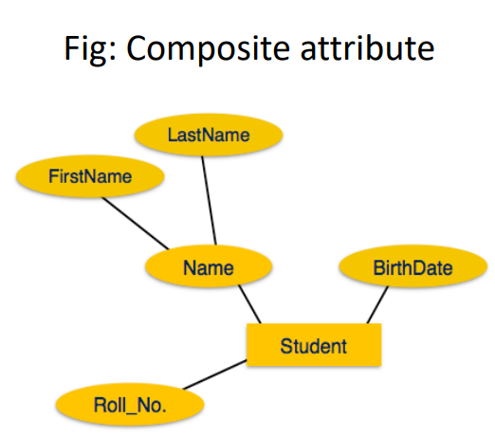

Slide 55
2.4 Attributes and keys:=>
Types of Attributes:=>
3. Derived Attributes:=>
Derived attributes have values that can be computed or derived from other attributes.
They are not stored directly but calculated when needed. For example, "Age" can be derived from the "Date of Birth.“
Derived attributes are depicted by dashed ellipse

Slide 56
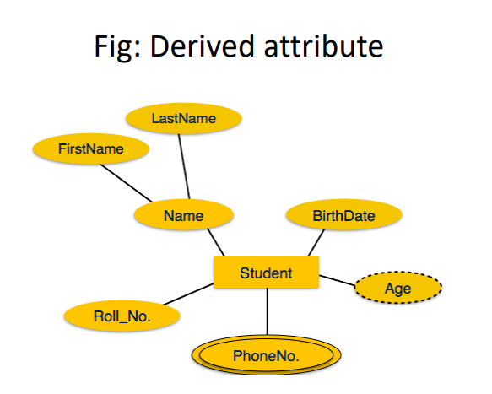

Slide 57
Types of Attributes:=>
4. Multi-valued Attributes: Multi-valued attributes can hold multiple values for a single entity. For instance, an entity "Person" might have a multi-valued attribute "Phone Numbers" to account for multiple phone numbers.

Slide 58
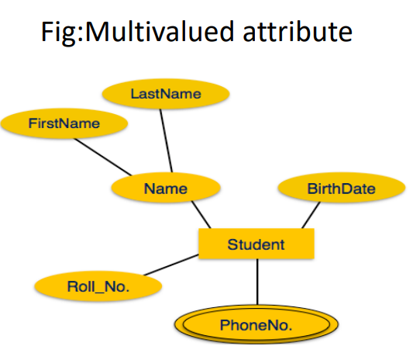
Types of Attributes:=>

Slide 59
2.4 Attributes and keys:=>
5. Key Attributes: =>
Key attributes are used to uniquely identify an entity within an entity set.
They ensure that no two entities within that entity set have the same value for the key attribute.
For example, in a "Student" entity set, "Student ID" can be a key attribute.

Slide 60
2.4 Attributes and keys:=>
6. Single-valued Attributes: Single-valued attributes can hold only one value for a given entity. For example, the "Date of Birth" attribute for a "Person" entity is single-valued.
7. Composite Key Attributes: In a composite key attribute, a combination of two or more attributes is used to uniquely identify an entity. For example, a combination of "Username" and "Domain" could be a composite key for an "Email" entity.

Slide 61
2.4 Attributes and keys:=>
Keys are attributes used to uniquely identify entities and ensure data integrity.
Keys are attributes or sets of attributes used to uniquely identify individual instances (entities) within an entity set.

Slide 62
2.4 Attributes and keys:=>
Types of keys:=>
Primary key:
Foreign key

Slide 63
2.4 Attributes and keys:=>
Types of keys:=>
a. Primary key:=>
A primary key is a unique identifier for each entity in the entity set.
It is used to ensure that no two entities share the same identifier.

Slide 64
2.4 Attributes and keys:=>
Types of keys:=>
b. Foreign Key: A foreign key is an attribute in one entity set that refers to the primary key of another entity set. It establishes relationships between entities.
c. Super Key: A super key is a set of one or more attributes that can be used to identify entities uniquely. It may contain more attributes than necessary to form a primary key.

Slide 65
2.4 Attributes and keys:=>
Types of keys:=>
d. Candidate Key: =>
A candidate key is a minimal super key, which means it is a super key without any redundant(duplicate or repetitive) attributes.
In a set of candidate keys, one is chosen as the primary key.

Slide 66
Question to do
=> What do you mean by attributes and keys in ER diagram? Explain with example . [4]

Slide 67
Understanding of super key
Super Key:
A super key is a set of one or more attributes (columns) that can be used to uniquely identify individual entities within an entity set. It may contain more attributes than are strictly necessary to form a candidate key or primary key. In other words, a super key is a broader concept that encompasses all possible keys for identifying entities.

Slide 68
Understanding of super key
Example of a Super Key:
Consider an entity set for "Students" with attributes "Student ID," "Email," and "Social Security Number." The combination of all three attributes (Student ID, Email, and Social Security Number) can be a super key because it can uniquely identify each student. However, it contains more attributes than needed for identification, making it a super key but not a candidate key.

Slide 69
Understanding of candidate key
Candidate Key:
A candidate key is a minimal super key, which means it is a super key with the fewest possible attributes required to uniquely identify entities within an entity set. In other words, it is a subset of a super key that still enforces the uniqueness constraint.

Slide 70
Example of a Candidate Key:
Example of a Candidate Key:
Continuing with the "Students" entity set, let's say that "Student ID" and "Email" are both attributes that can be used to uniquely identify students. However, "Social Security Number" is not necessary for identification because "Student ID" or "Email" alone can serve as a key. In this case, "Student ID" and "Email" are candidate keys because they are minimal sets of attributes that can uniquely identify each student.

Slide 71
2.5. Relationship types and sets
In the Entity-Relationship (ER) model of a database management system (DBMS), relationships play a crucial role in defining how entities (objects or things) are related to each other.
There are various types of relationships and sets in the ER model.
There are four types of mapping cardinality Let's explore these concepts:

Slide 72
Types of Relationships:
One-to-One (1:1) Relationship: In a one-to-one relationship, each entity in one entity set is related to exactly one entity in another entity set, and vice versa. For example, a "Person" entity might be related to a "Passport" entity, where each person has one unique passport.

Slide 73
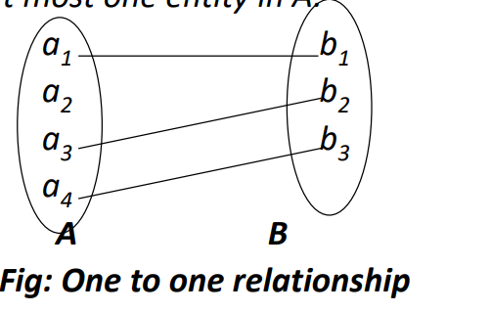

Slide 74
Types of Relationships:
2. One-to-Many (1:N) Relationship: In a one-to-many relationship, each entity in one entity set can be related to multiple entities in another entity set, but each entity in the second set is related to only one entity in the first set. For instance, in a "Department" and "Employee" relationship, each department can have multiple employees, but each employee belongs to only one department.

Slide 75
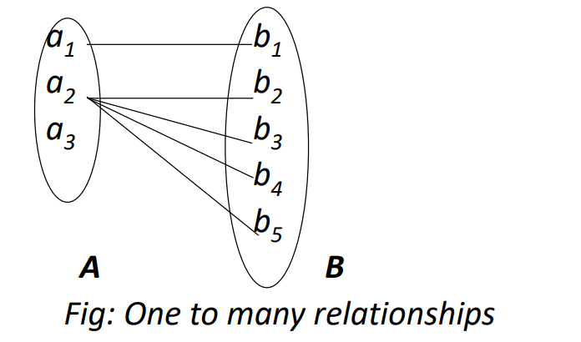

Slide 76
Types of Relationships:
3. Many-to-One (N:1) Relationship: This is essentially the reverse of a one-to-many relationship. Many entities in one entity set can be related to a single entity in another entity set. For example, in a "Teacher" and "Class" relationship, many teachers can teach a single class.

Slide 77
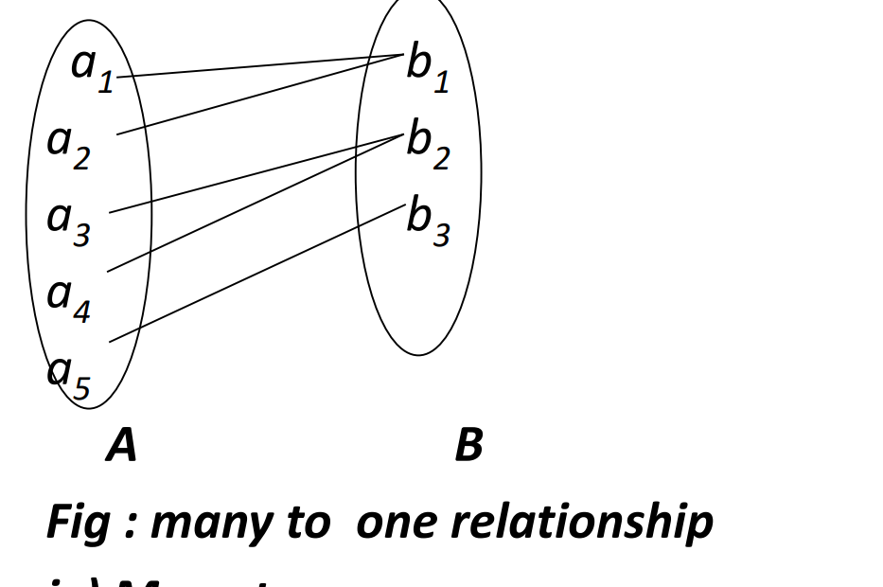

Slide 78
Types of Relationships:
Many-to-Many (N:N) Relationship: In a many-to-many relationship, multiple entities in one entity set can be related to multiple entities in another entity set. For example, in a "Student" and "Course" relationship, each student can enroll in multiple courses, and each course can have multiple students.

Slide 79
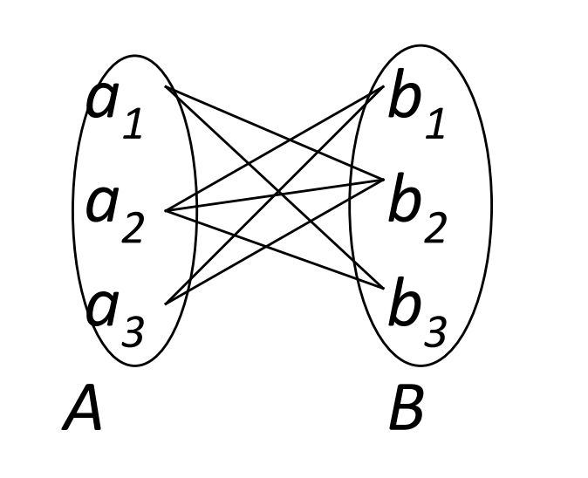

Slide 80
Sets in data model
In the context of data modeling in a database management system (DBMS), a "set" typically refers to a collection of related data elements, often organized according to a particular structure or schema.
Sets are used to group and manage data elements with shared characteristics or properties

Slide 81
E-R diagrams
The overall logical structure of a database can be expressed graphically by E-R diagram which consist of following components : -
Rectangles, which represent entity sets. - Ellipses, which represent attributes.
- Diamonds which represent relationships among entity sets
-Lines, which links attributes to entity sets and entity set to relationship

Slide 82
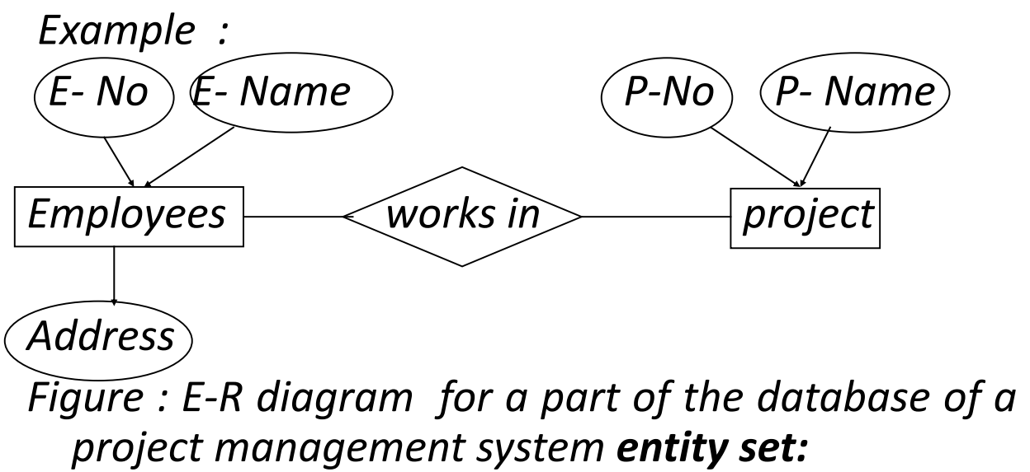

Slide 83
Question to do :=>
2. Explain ER diagram. What are entity, attributes and keys? Describe different types of relationship.[4+2+4]
3. What is an attribute? Define one to one and many to many relationship.

Slide 84
Question to do
4. Draw an E-R diagram of the following:
hospital management system
School management system
Hotel management system

Slide 85
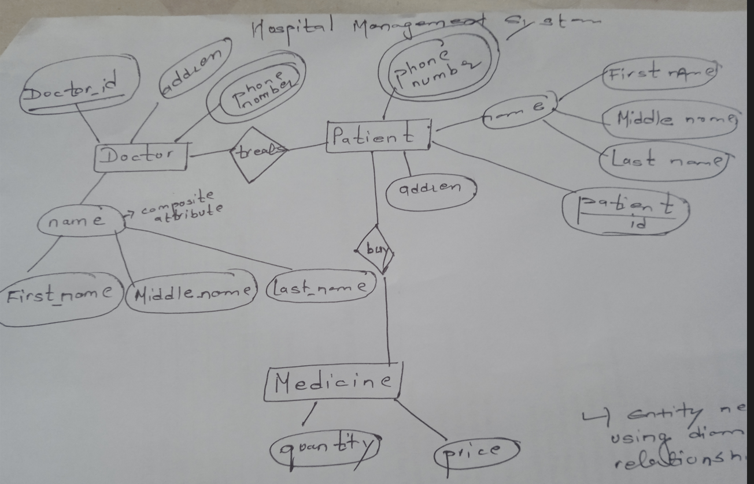

Slide 86
E-R diagram of school management system=>
????

Slide 87
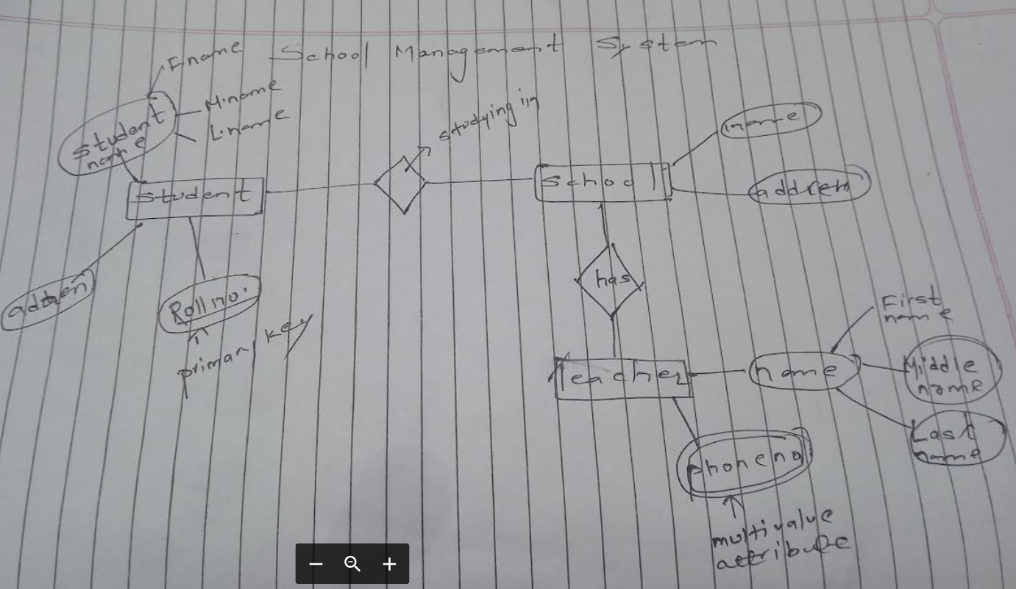

Slide 88
E-R diagram of library management system=>
????

Slide 89
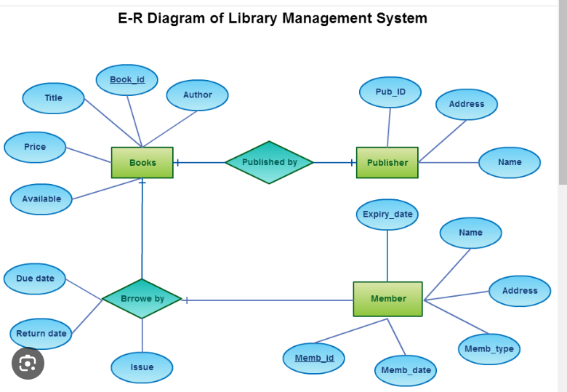

Slide 90
E-R diagram of hotel management system=>
????

Slide 91
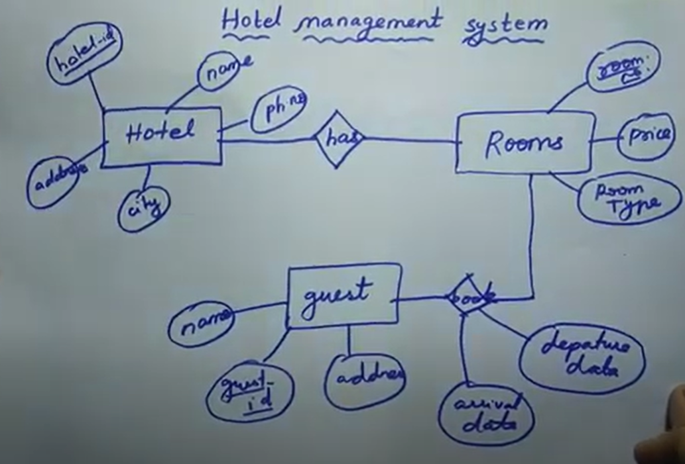

Slide 92
THANK YOU

